Slide 1
I get knocked down, but I get up again:
Perseverance in the Ministry of Reconciliation

Slide 2
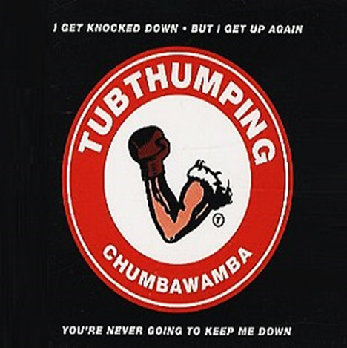

Slide 3
"It is essential to be drunk all the time. That's all: there's no other problem. If you do not want to feel the appalling weight of Time which breaks your shoulders and bends you to the ground, get drunk, and drunk again.”
Charles Pierre Baudelaire 1821-1867

Slide 4
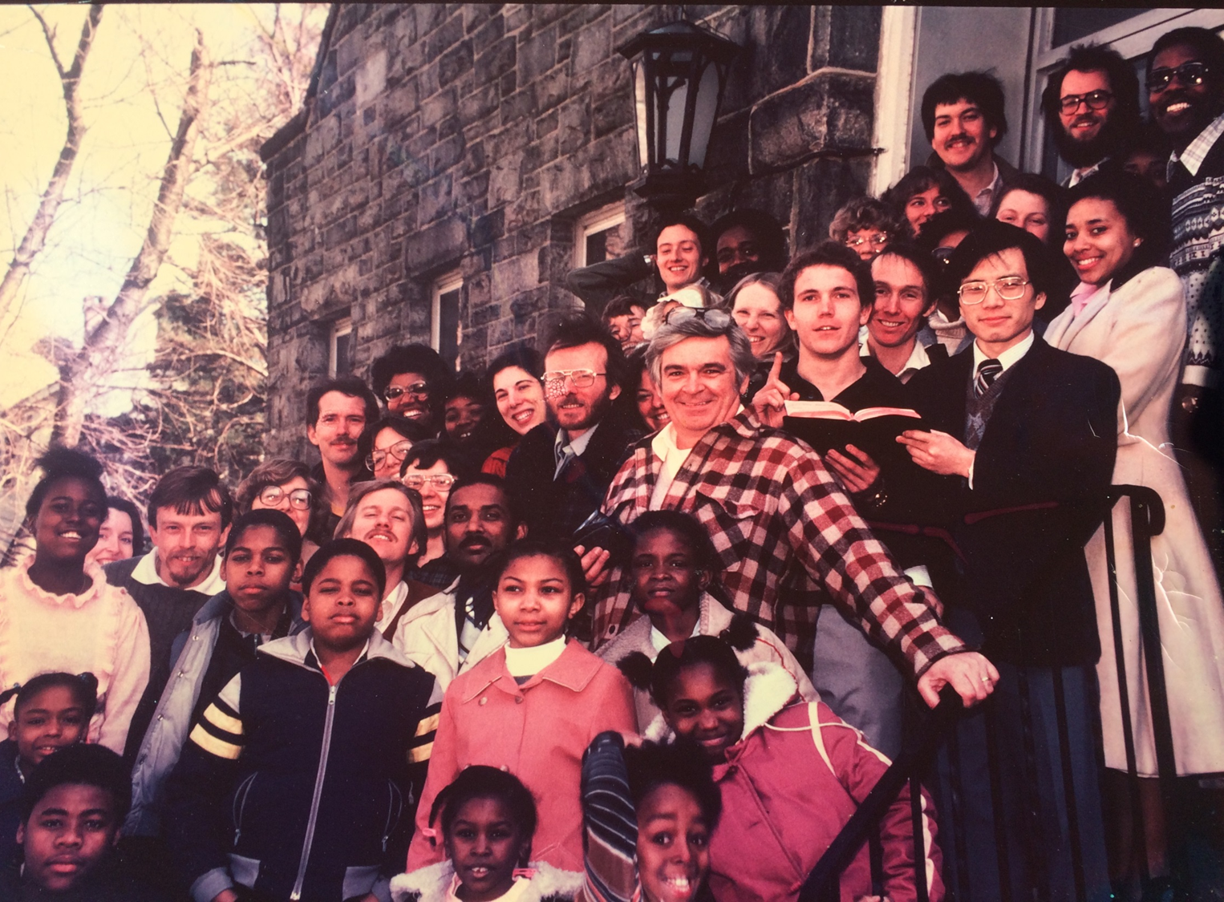
FCF 1983

Slide 5
“Do not get drunk on wine, which leads to debauchery. Instead, be filled with the Spirit.”
Ephesians 5:18

Slide 6
Speak to one another with psalms, hymns and spiritual songs. Sing and make music in your heart to the Lord, always giving thanks to God the Father for everything, in the name of our Lord Jesus Christ.
Ephesians 5:19

Slide 7
“ I cry aloud to the LORD;
I lift up my voice to the LORD for mercy.
I pour out my complaint before him;
before him I tell my trouble.”
Psalm 142:1,2
“He disburdened his cares unto God. ….he did not give way before people to loud and senseless lamentations, neither did he suffer himself to be tormented with inward and suppressed cares, but made known his griefs with unquestioning confidence to the Lord.”
— Calvin.

Slide 8
“Writing in a prayer journal helps us take stock of our location on the journey…. we can reflect on what God is doing, …instead of reacting to life…., it quiets our souls. It’s okay to have a busy life. Its crazy to have a busy soul.”
Paul Miller, A Praying Life

Slide 9
Resilience in Ministry:
Not so much prevention but self-care and recovery
Burnout – Physical, emotional and mental exhaustion caused by long-term involvement in an emotionally draining situation. (Langberg)
Compassion Fatigue- Accumulated weariness from daily work of entering the sorrow of others with a compassionate response.
Secondary Distress – exposure to details of stories and distressing facts over time causes caregivers to begin to have the same emotions

Slide 10

Right Theology, Right Thinking
God’s Word is foundational for resilience
a theology of reconciliation will demand a theology of suffering
Your capacity for ministry is directly related to your capacity for suffering

Slide 11
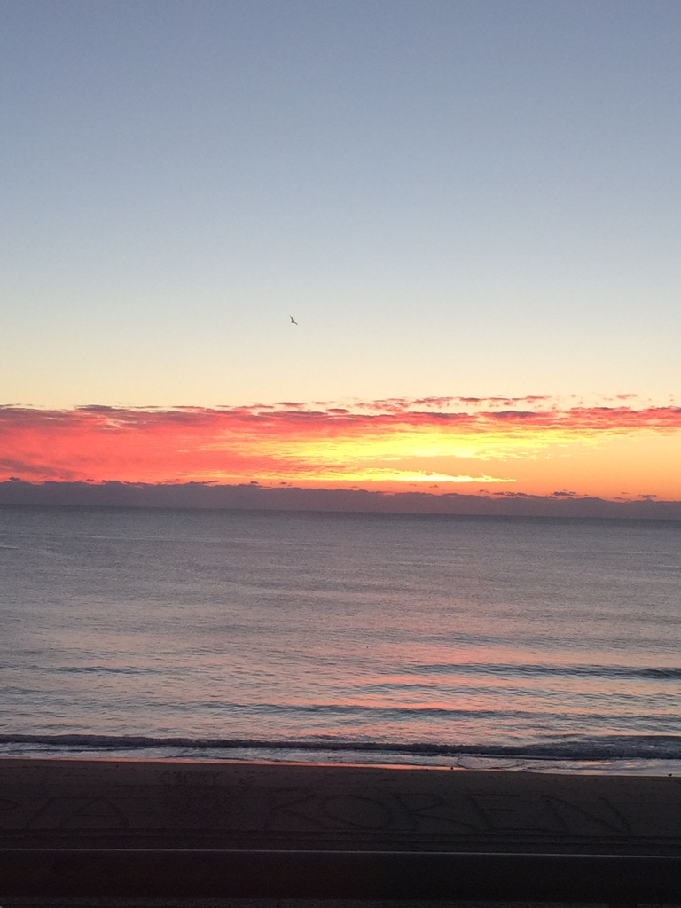
Right Gratitude
Praise: A Godward focus restores
“Praise God in his sanctuary; praise him in his mighty heavens.
Praise him for his acts of power;
Praise him for his surpassing greatness.” Ps. 150
”Worship is like the REM of soul rest. Ministry is like PTSD for your whole life. It beats you up, beats your family up. There’s no rest because of the ‘ceaseless work of our self-validation.’”
(Ray Cortese)

Slide 12
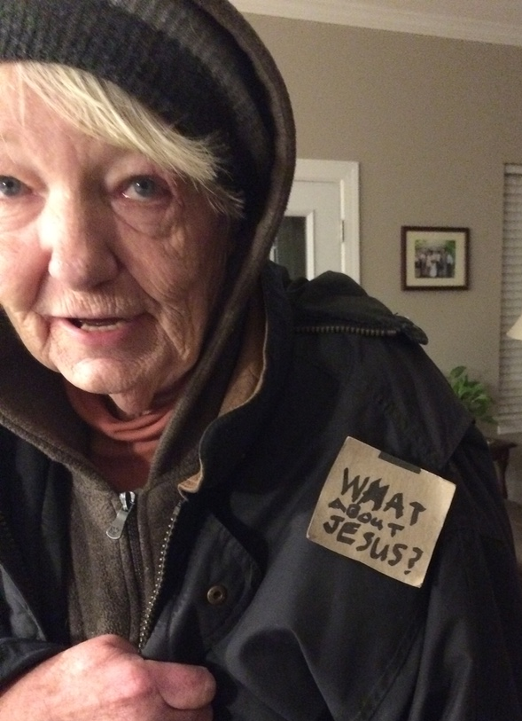
How Gratitude Changes Us
“Feeling grateful activates the brain stem region that produces dopamine…
Gratitude toward others increases activity in social dopamine circuits, which makes social interactions more enjoyable..
”Labeling your negative emotions makes them less powerful... describe an emotion in just a word or two , and it helps reduce the emotion.

Slide 13
Right Gospel:
Living in The Now-and-Not-Yet
The verdict is in!
We have the righteousness of Christ!
“There is therefore now no condemnation for those who are in Christ Jesus because the law of the spirit of life has set us free from the law of sin and death.”
Rom. 8:1

Slide 14
Right People: Community
“It begins by being with God in solitude; then it creates a fellowship, a community of people with whom the mission is being lived; and finally, this community goes out together to heal and to proclaim good news.”
Henri Nouwen,
“Moving from Solitude to Community to Ministry”
MRI study: “social exclusion activates the same circuitry as physical pain.”
Right Pauses: Sabbath Rest

